Slide 1
MDCT Project and Perceptual Similarity in Image Compression
Moeez Amjad -65053
Muhammad Hamza Aslam-70413
Sajid Ali khan-66414

Slide 2
Introduction
Problem Statement:
Aim: To analyze the effectiveness of image compression using MDCT compared to DCT.
Focus: Evaluating perceptual similarity, compression ratio, and bits per pixel (BPP).
Solution Approach Overview:
MDCT and DCT for images.
Perceptual similarity metrics using the LPIPS model.

Slide 3
Background
DCT:
Time Domain data point -> Sum of Cosine functions
Most of the information is concentrated into few frequency components
Many high frequency components discarded or reduced
MDCT:
Divides the image into segments which are overlapped with each other
The overlapping nature of MDCT ensures that the transitions between segments are smoother to reduce the Artifacts

Slide 4
Implementation
Finding of optimum MDCT window.
MDCT Encoding and Decoding of Images.
DCT Encoding and Decoding of Images.
PSNR Value and Compression Ratio of DCT/MDCT
Perceptual Similarity and Compression Ratio Metrics for MDCT and DCT.

Slide 5

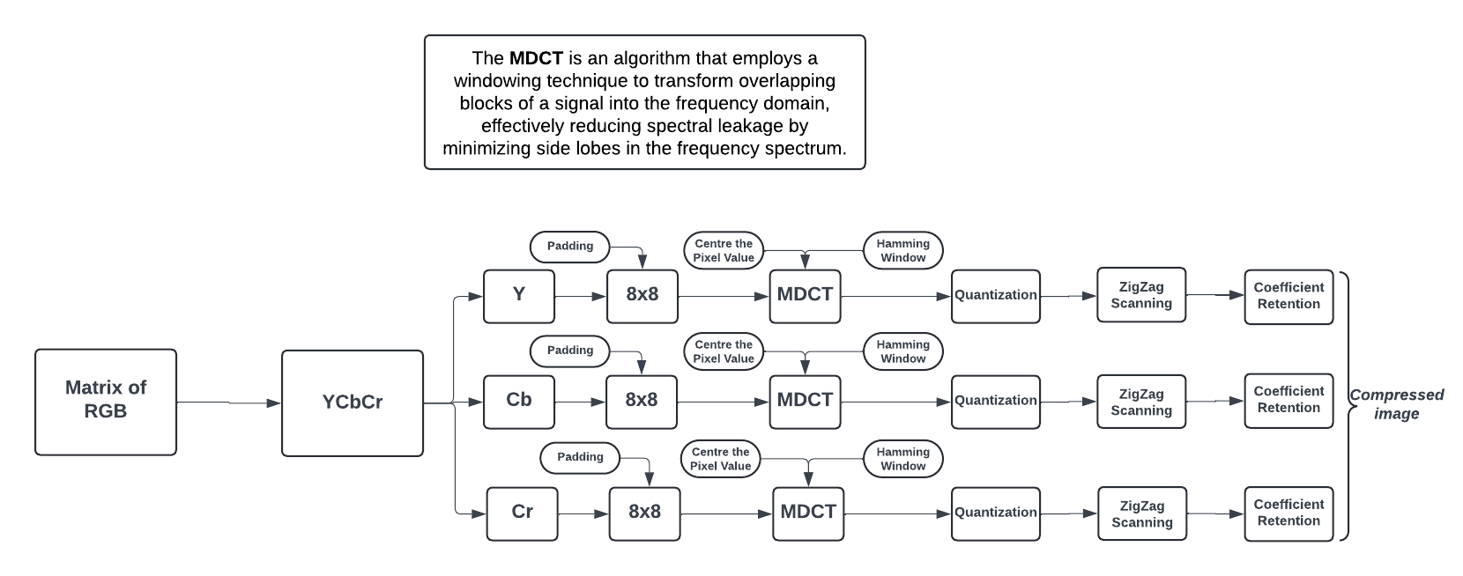

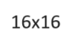





MDCT Compression

Slide 6
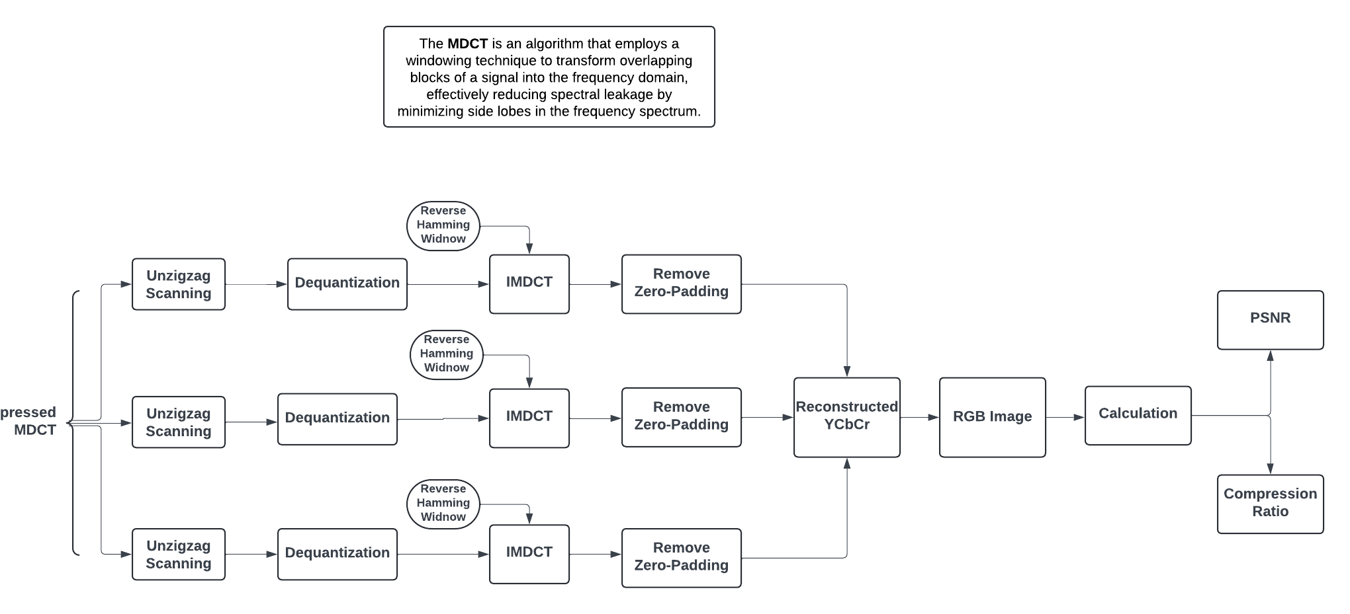


Inverse MDCT

Slide 7
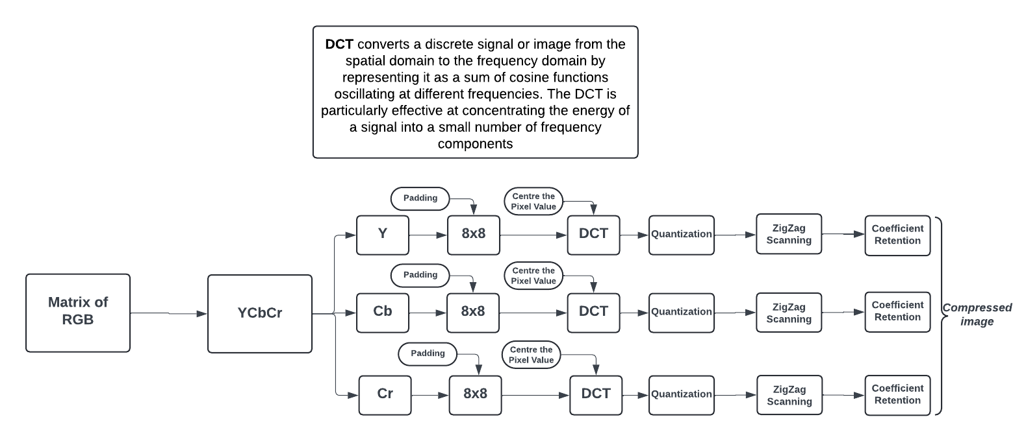
DCT Compression

Slide 8
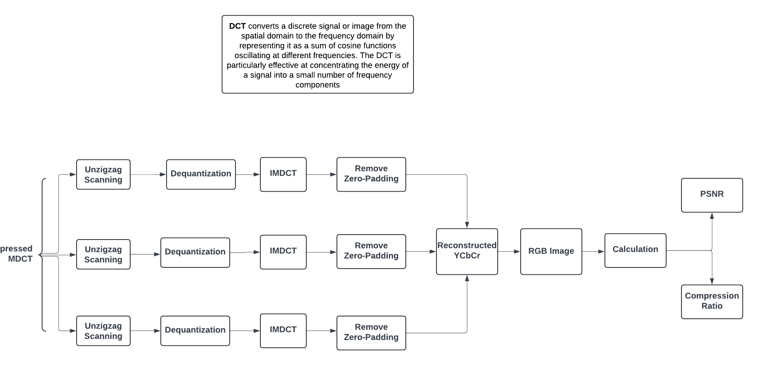
Inverse DCT

Slide 9
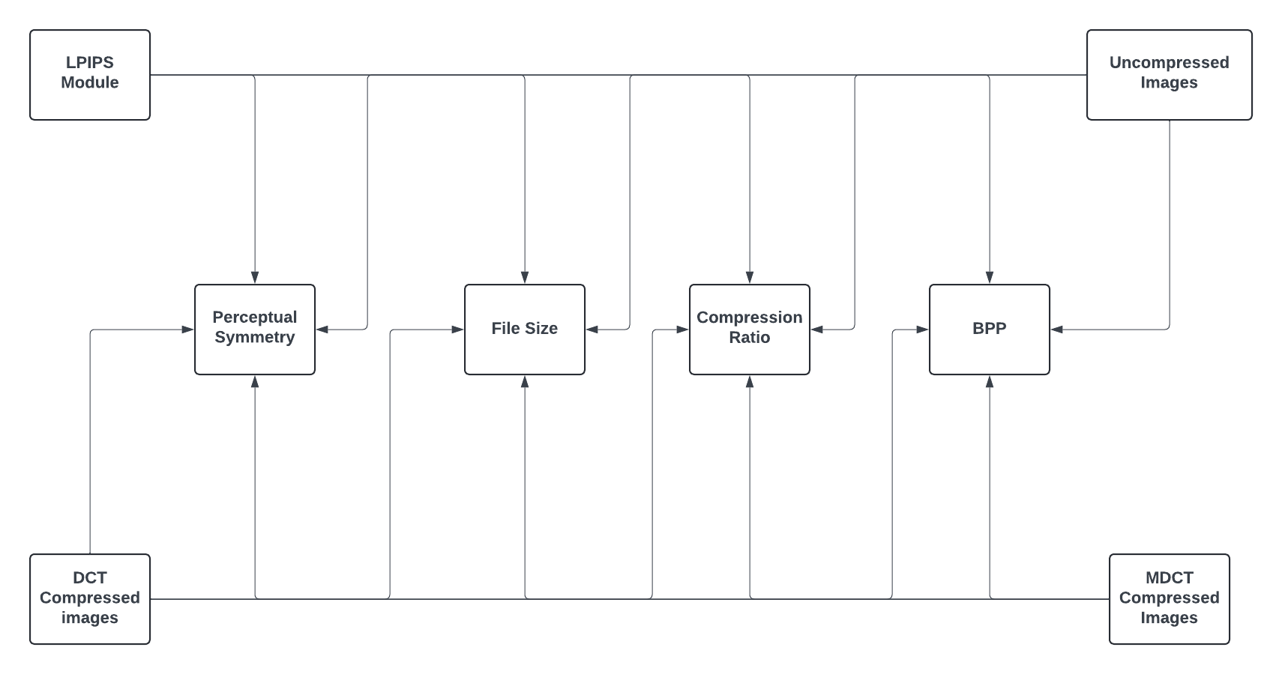
Perceptual Symmetry and Compression Metrics

Slide 10
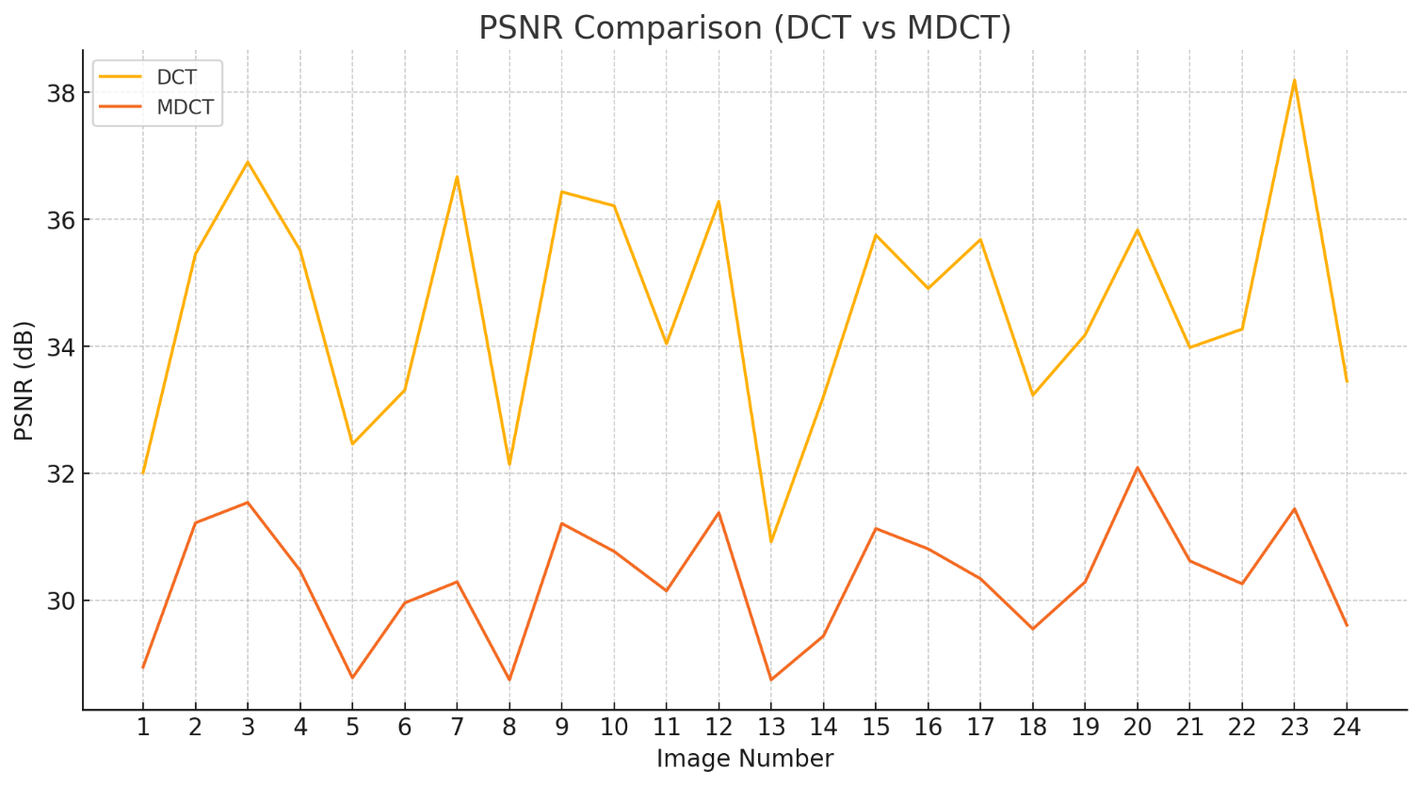
Results: PSNR Comparison between DCT & MDCT

Slide 11
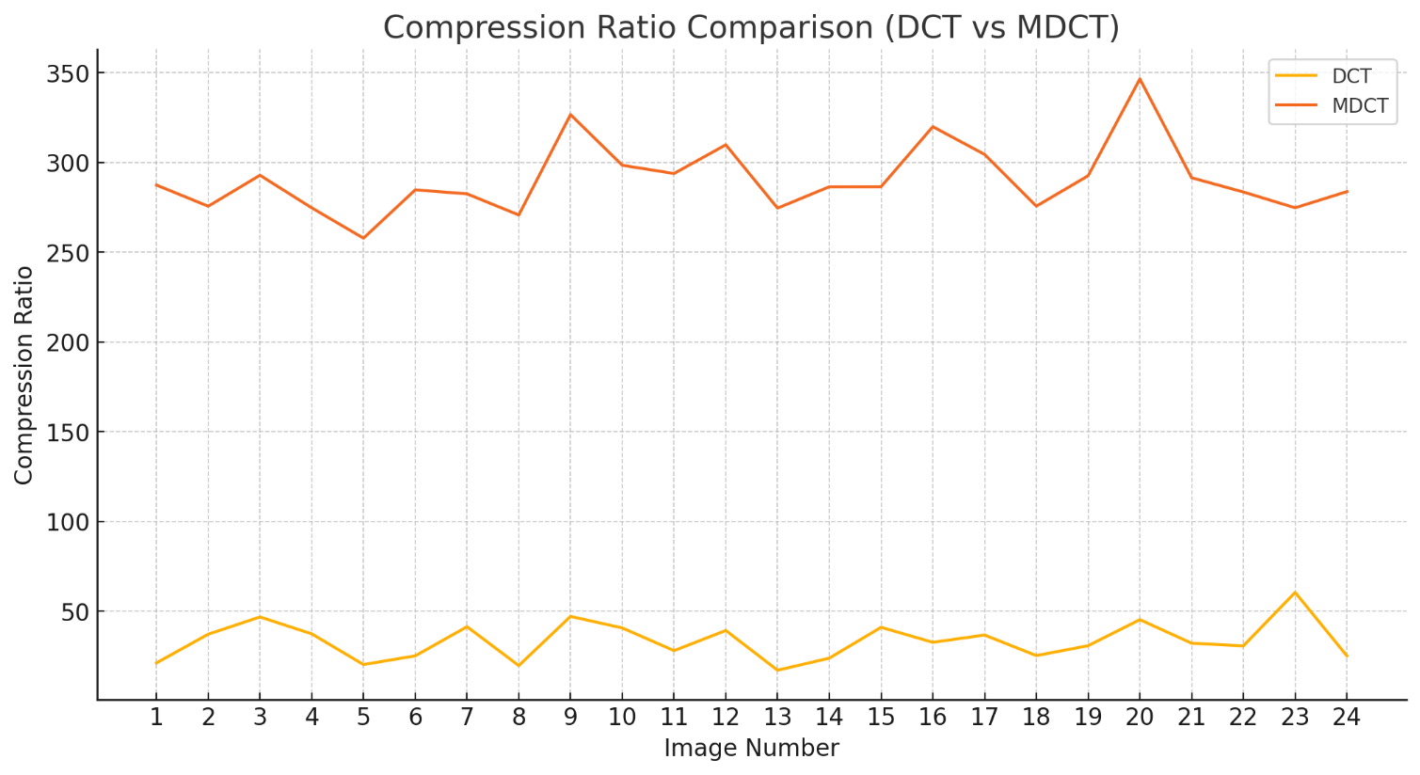
Results: Compression Ratio of DCT Vs MDCT

Slide 12
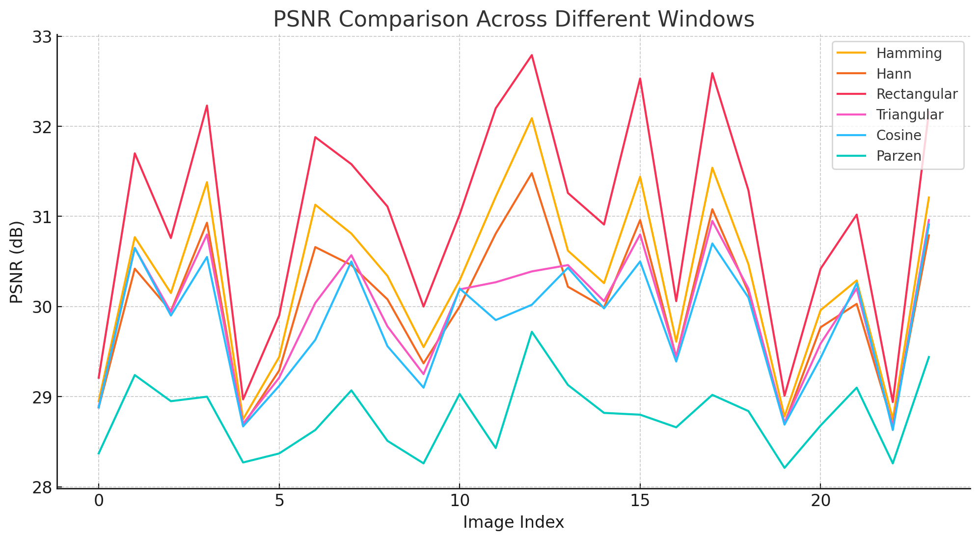
Results: MDCT PSNR

Slide 13
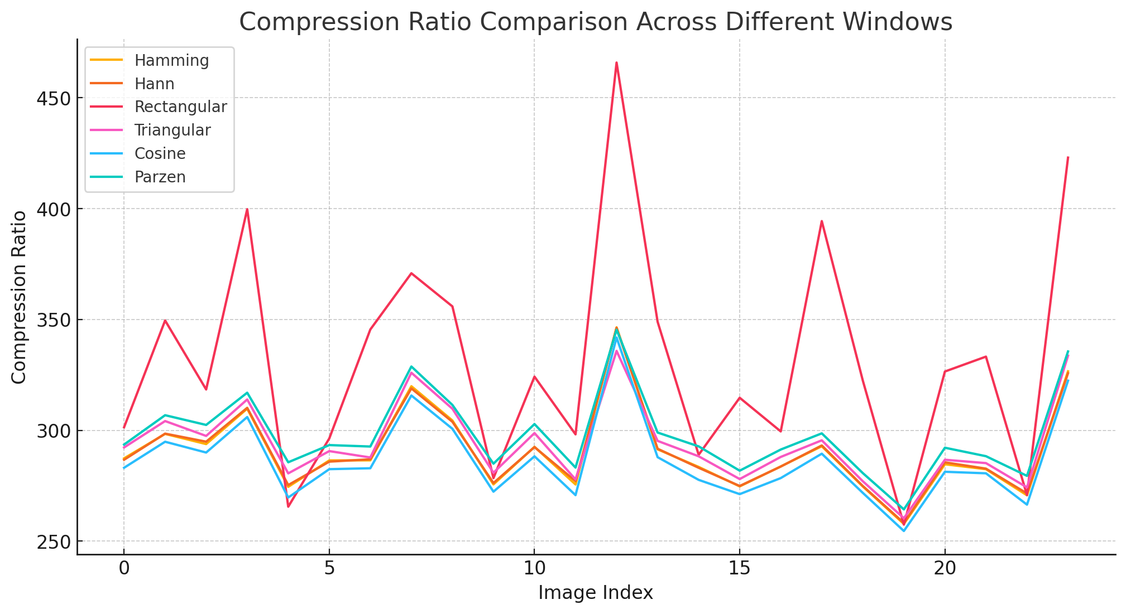
Result: MDCT Compression Ratio

Slide 14
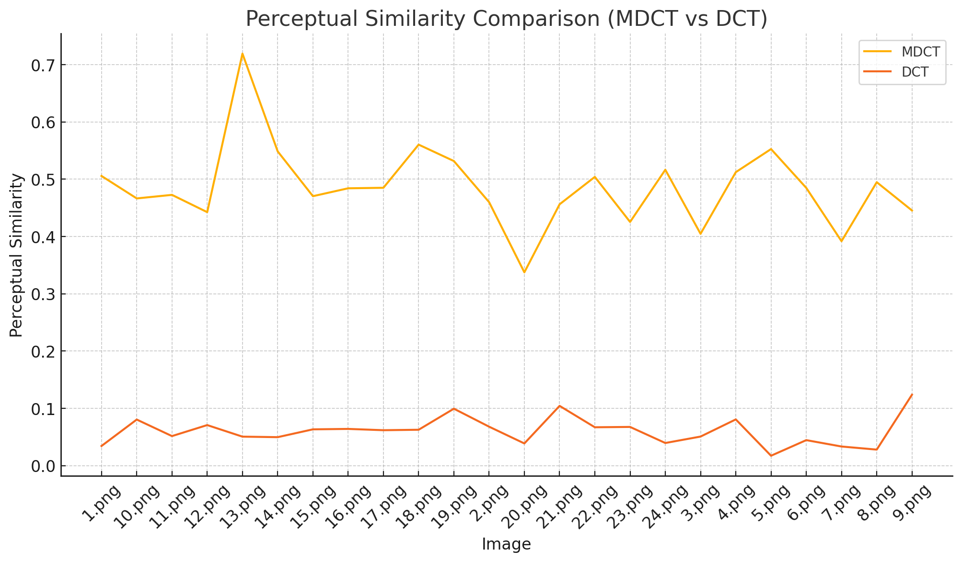
Results: Perceptual Symmetry

Slide 15
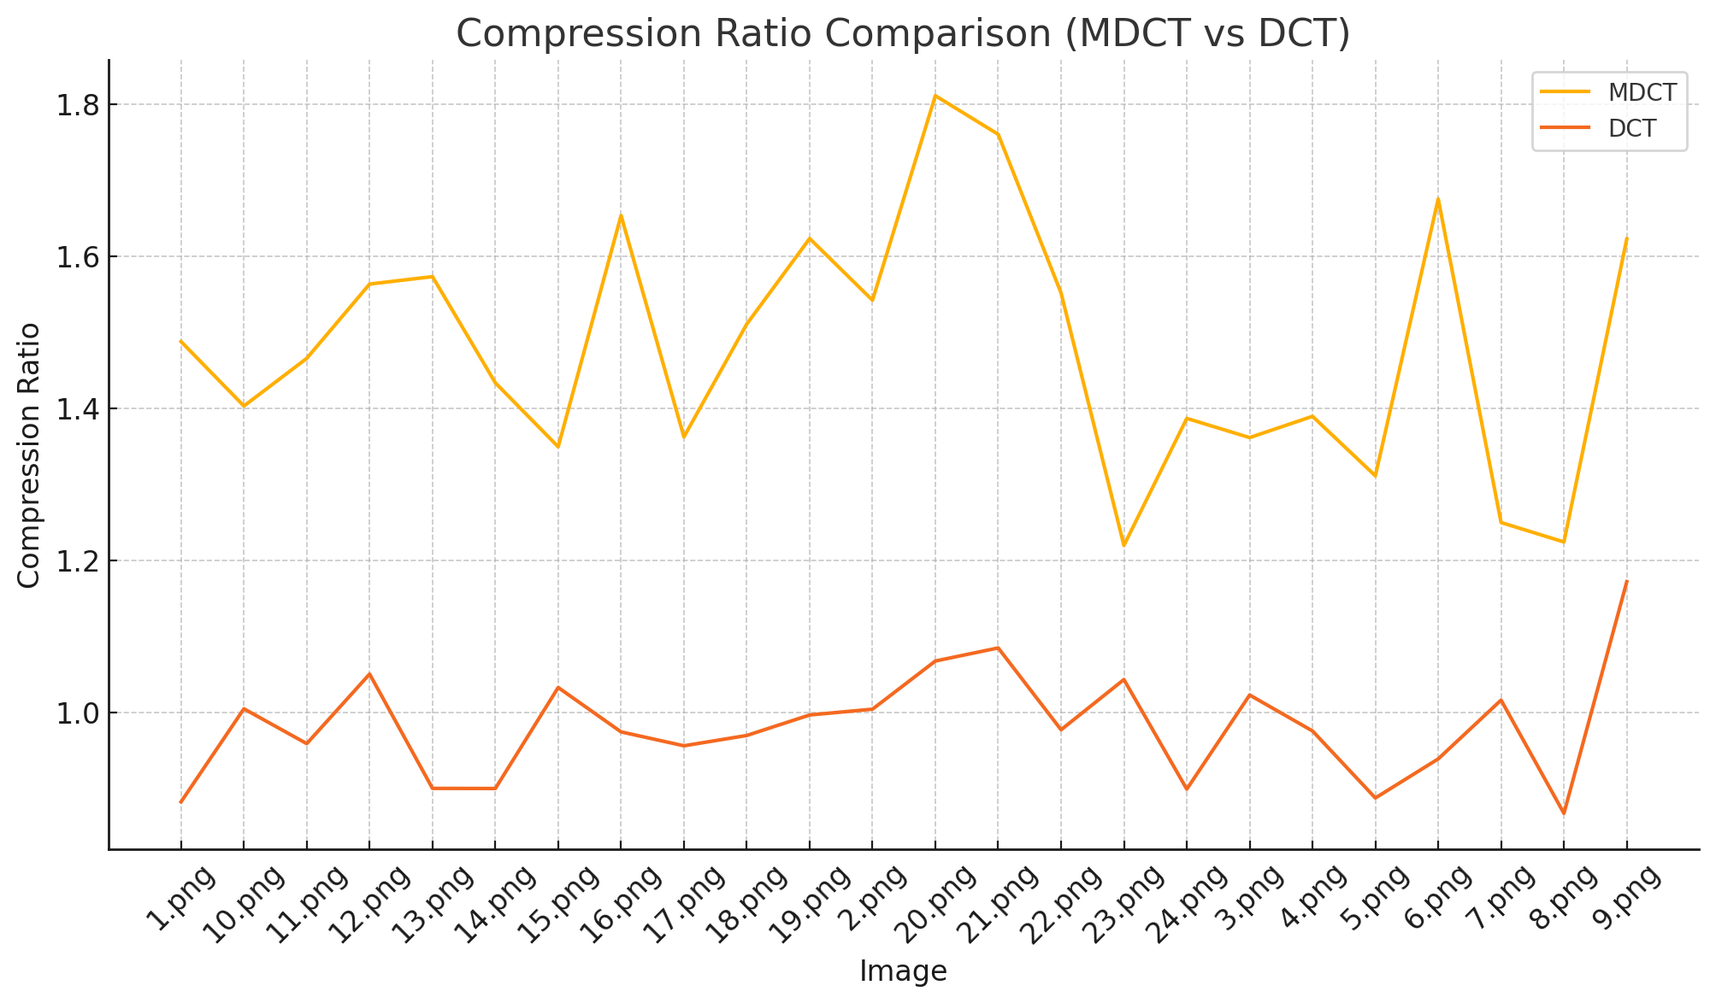
Result: Compression Metric

Slide 16
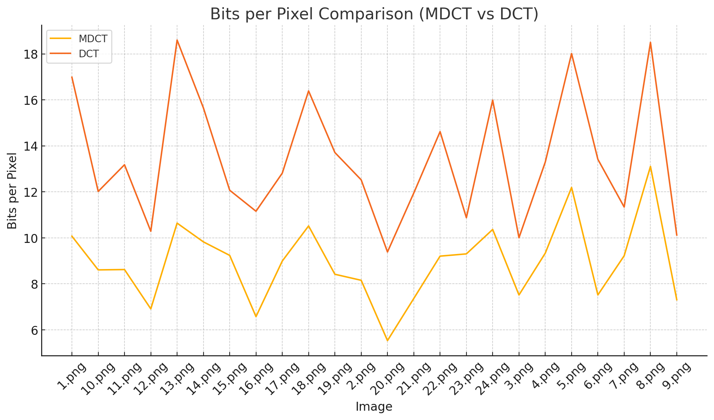
Result: Bits Per Pixel

Slide 17
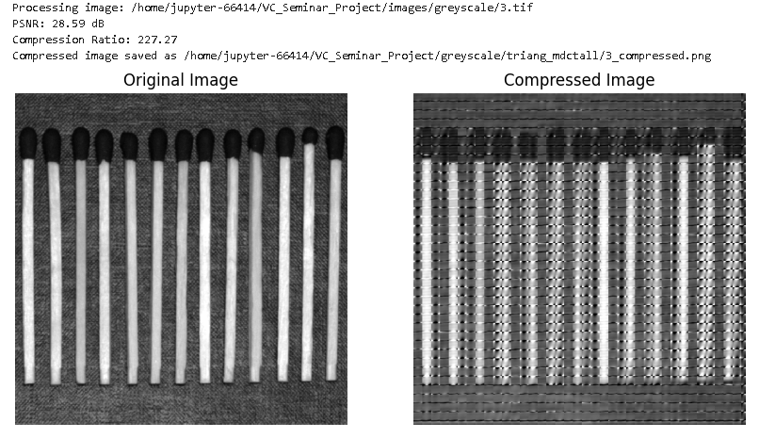
Grey scale MDCT

Slide 18
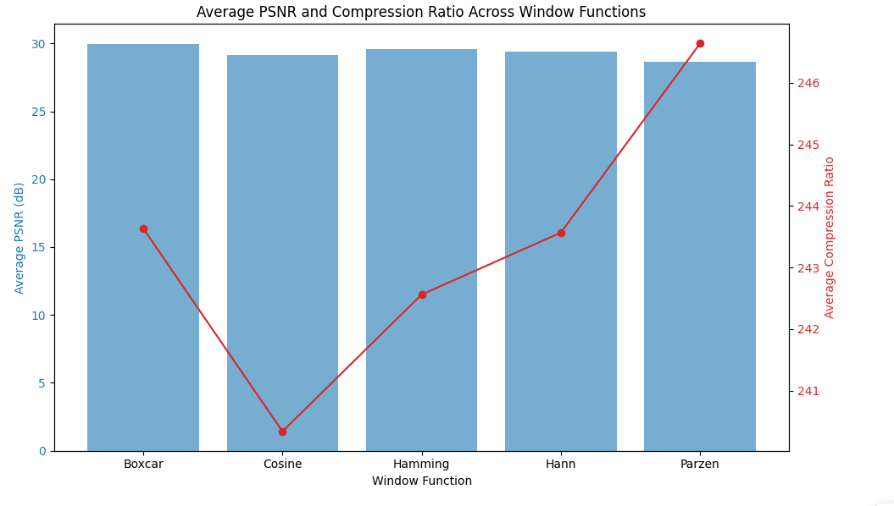
WINDOWS PLOT

Slide 19
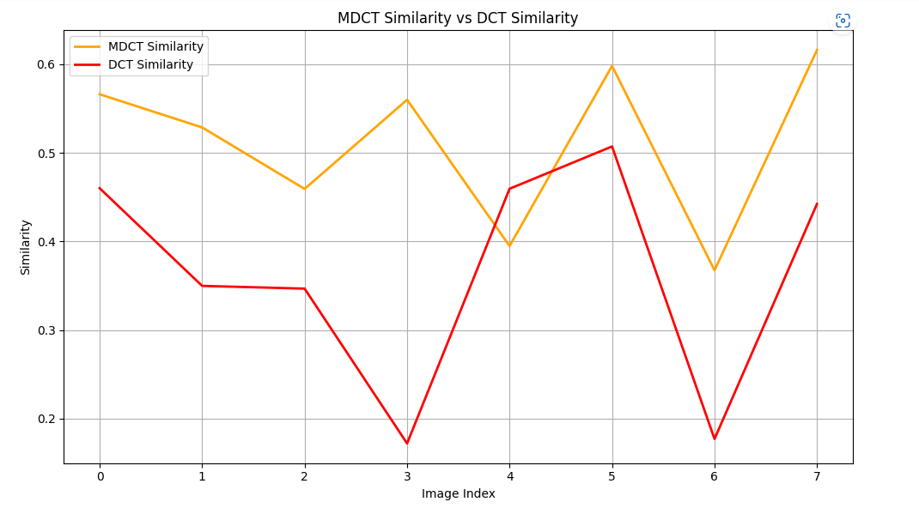
Results:perceptual

Slide 20
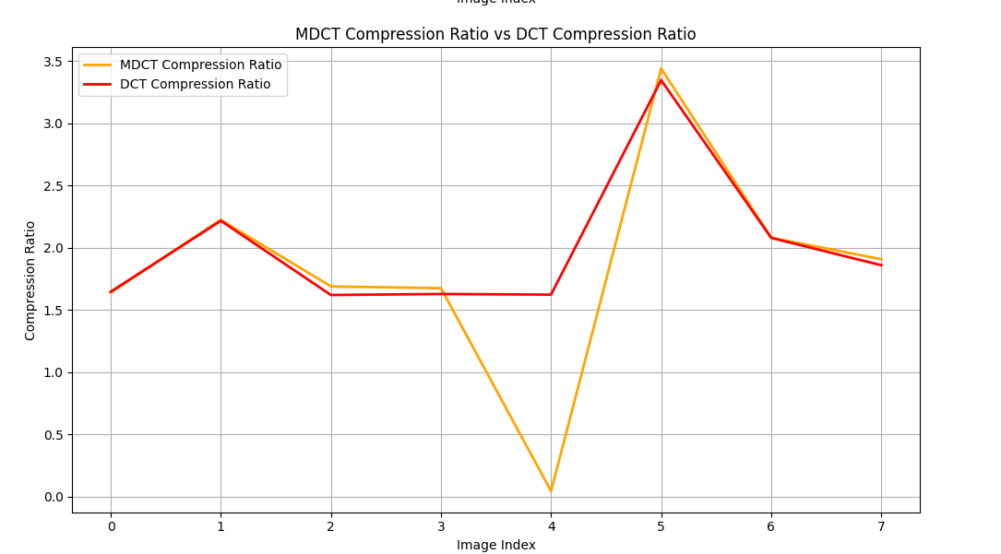
Results :compression ratio

Slide 21
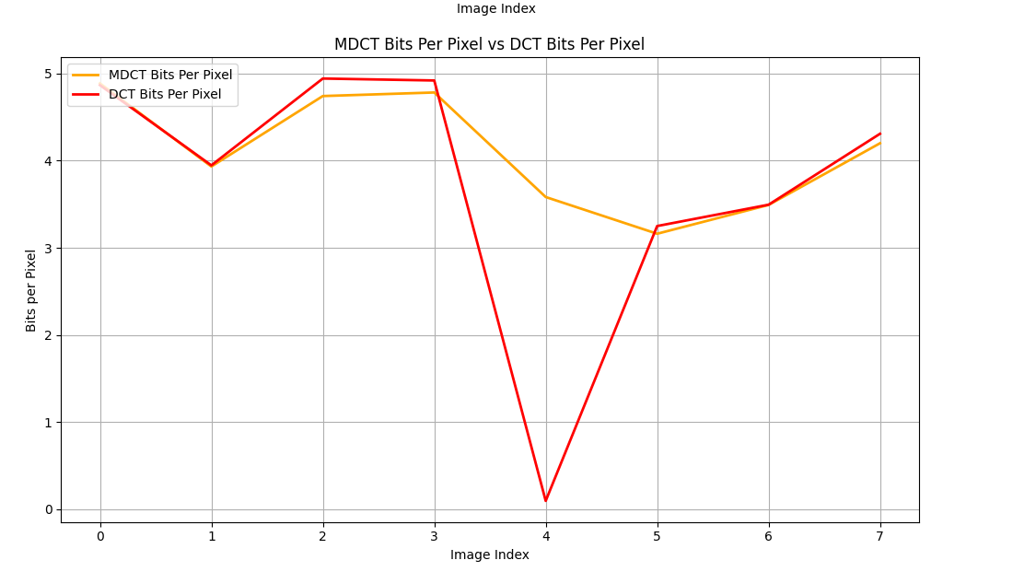
Results:Bit per pixel

Slide 22

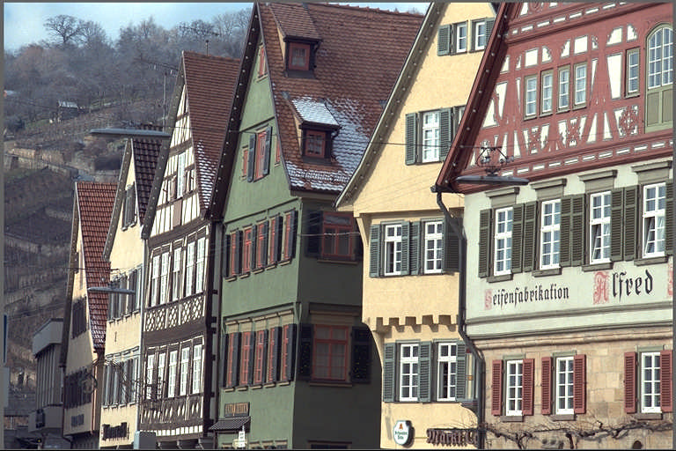
Results: DCT Compressed Image

Slide 23

Results: MDCT Compressed Image with Rectangular Window

Slide 24
Conclusion
MDCT > DCT : Perceptual Symmetry and Compression Ratio
DCT >MDCT : PSNR Value and Image Quality
Trade-off between DCT’s image quality and size and for MDCT’s compression ratio and perceptual similarity.
MDCT can be use where storage is the point of concern like low end Processors.
DCT can be used where quality is the point of concern like HD Cameras.

